Slide 1
Predicting the 2024 Euros
Adam, Mihir, Sachin

Slide 2
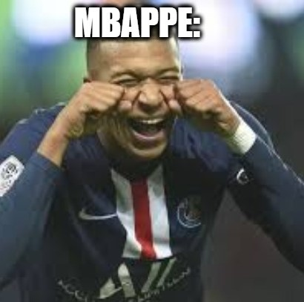
What Are The Euros?
The UEFA European Championships (Euros) are the continental equivalent of the World Cup for Europe.
24 Teams qualify through a qualification tournament
Put into 6 groups of 4, with the top 2 teams and 4 best third place teams progressing.
Points system within groups: Win is worth 3, Draw worth 1, Loss, 0.
All teams play each other round-robin style
Single elimination 16-team bracket until a winner is determined
Hosted in Germany this year

Slide 3

Data
Data from kaggle.com - spreadsheet contained all international football results from 1872 to present. https://www.kaggle.com/datasets/martj42/international-football-results-from-1872-to-2017
We limited it to Euros and World Cup matches, qualification tournaments, and friendlies from the start of the last Euros (June 2021), to early 2024.
We used the scorelines of each countries’ matches to predict the results of the tournament.
Extra weight put on 2021 Euros and 2022 World Cup matches

Slide 4
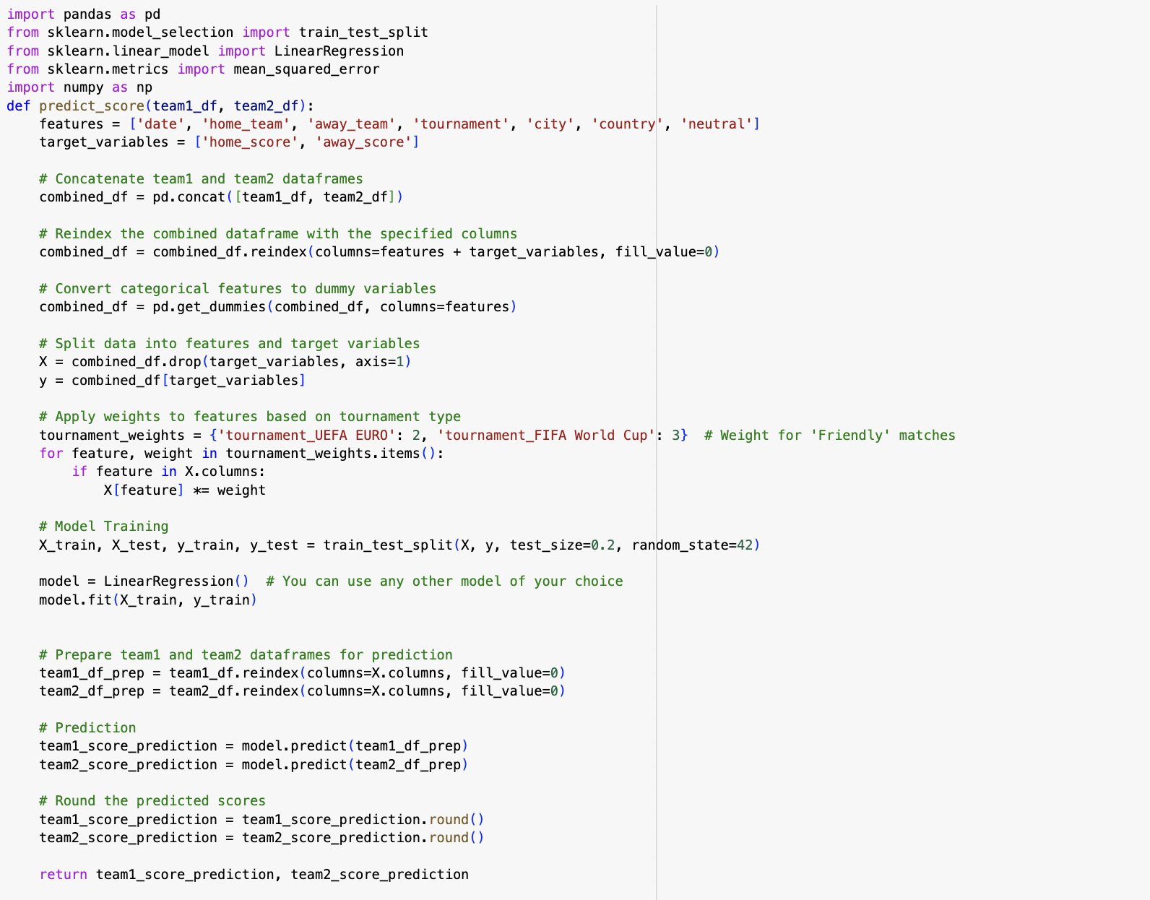
Methodology
Created a function to predict the scores of home and away teams (2 parameters)
Features: input variables to predict target variables
Target variables: variables we are trying to predict
Split the data into training and test set and trained Linear Regression Model
Predict scores for both teams using trained model, returns scores for both teams

Slide 5
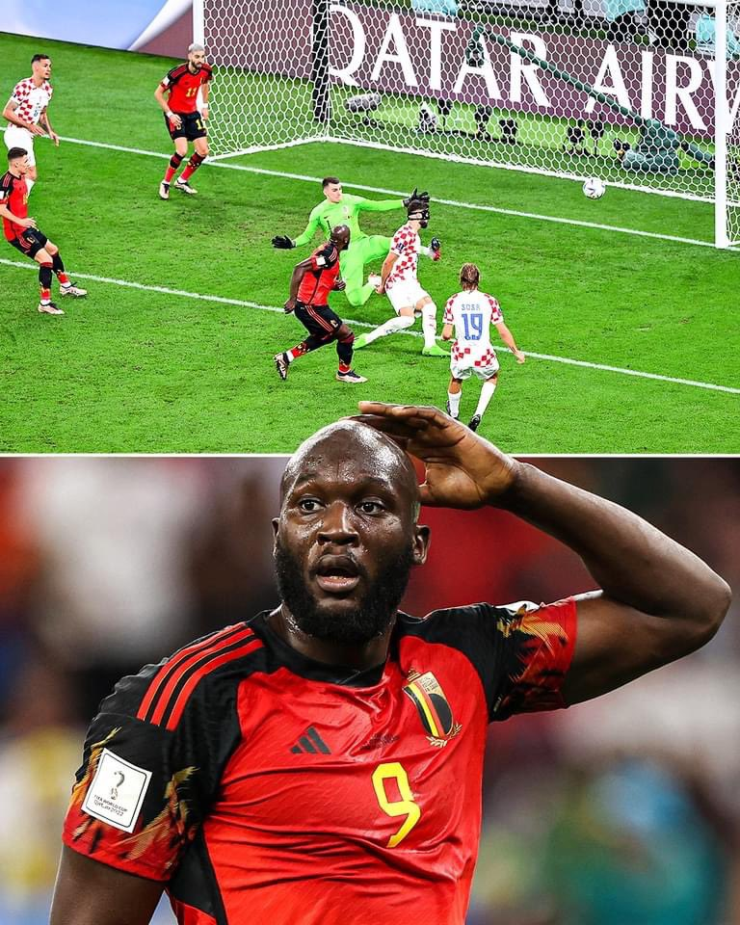
Additional Methodology comments
With Linear Regression, features and target ⇒ assumed linear relationship
Use coefficients (weights) for certain features that have more effect
Ex: tournament→ EUROs and WC have an impact on score and team performance
Model’s performance = evaluated by the mean squared error (average squared difference between actual and predicted values)

Slide 6
How good is the model?
Higher MSE for Home teams vs Away Teams
Home score MSE 4.1, average error around 2 goals, high in soccer
Away score MSE, 1.6, average error around 1.25 goals, ok but could be improved
Playoffs also similar results with slightly higher MSE values

Slide 7
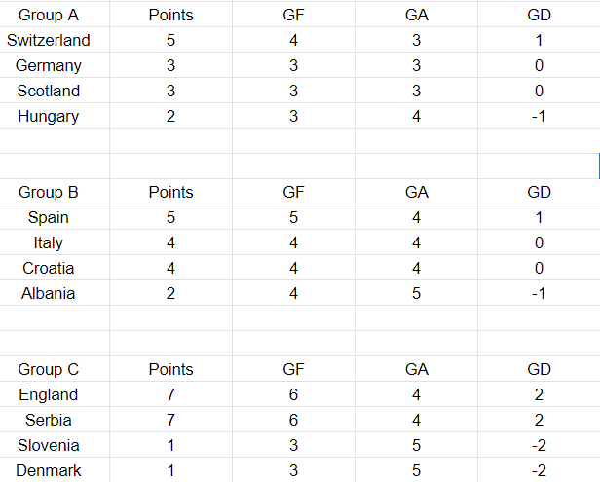
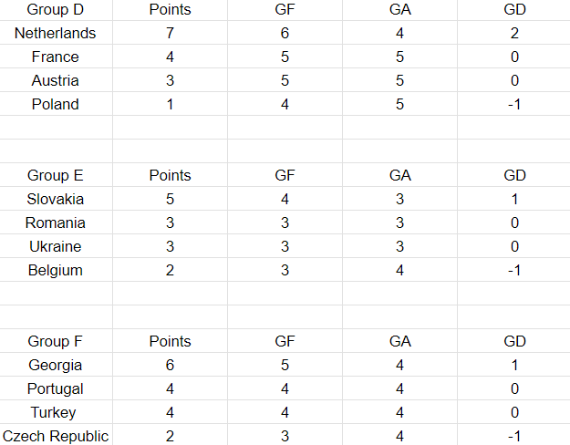
Group Stages

Slide 8
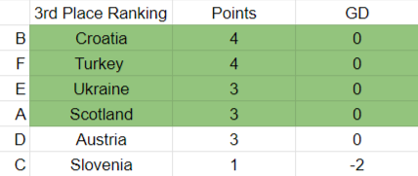
Third Place Rankings

Slide 9
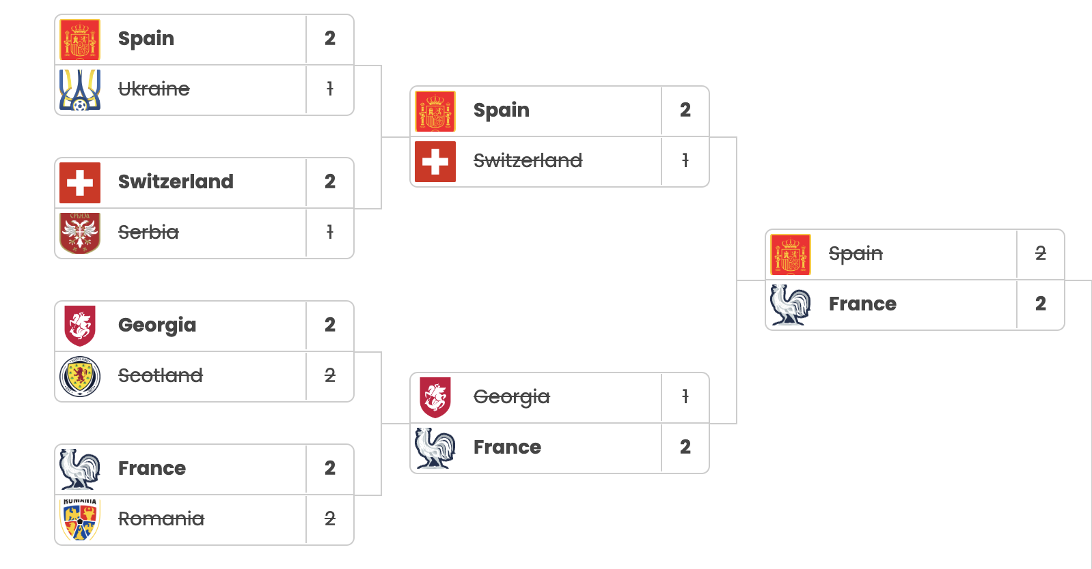
Knockouts

Slide 10
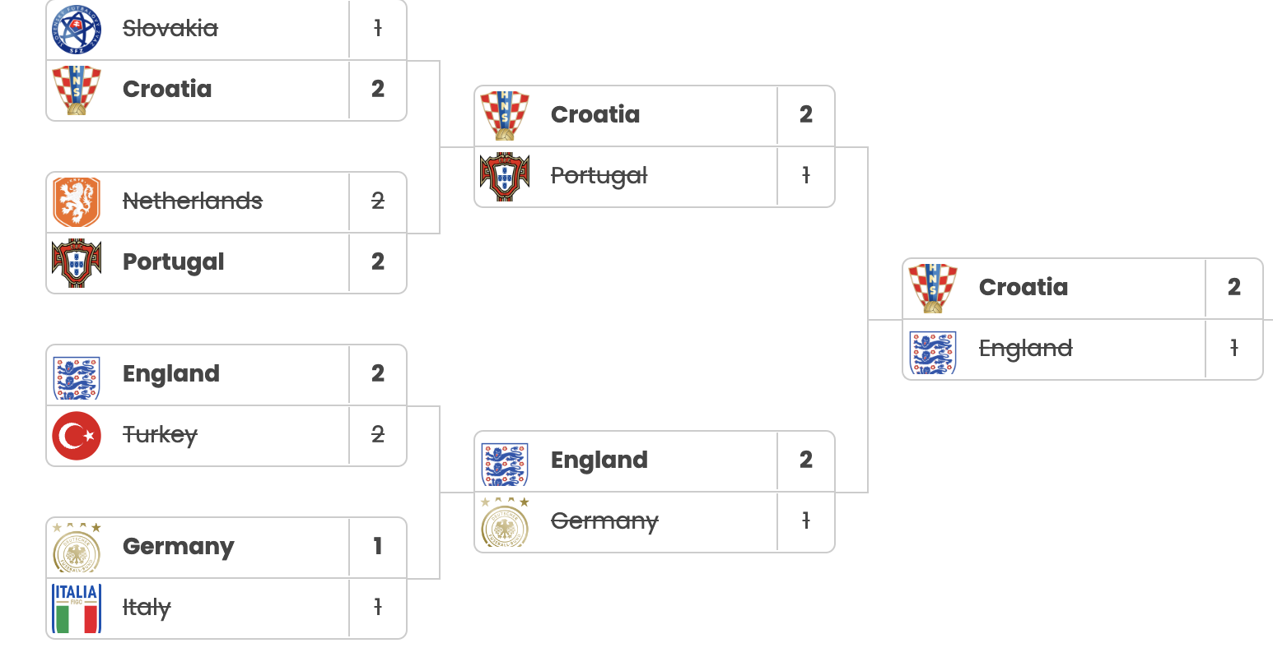
Knockouts

Slide 11
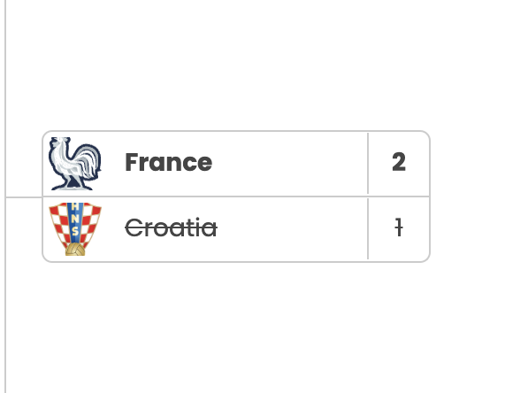
Final
Lot of penalty results (we chose higher-ranking team)
Teams that did well at the 2022 world cup (England, France, Croatia) did very well
More surprises in the groups than in the knockouts

Slide 12
Limitations/Improvements
Only uses results for the prediction - no way to account for recent managerial/personnel changes, stadium atmospheres/dynamics, etc.
Limited features, adding more features could improve model
Strength of schedule
European qualifying is notoriously unbalanced, leading to big teams having easy matchups and sometimes winning games by double digits, which is not representative of difficulty in the tournament.
Pedigree matters in tournaments - countries with a history of winning generally do better, no matter current form.

Slide 13
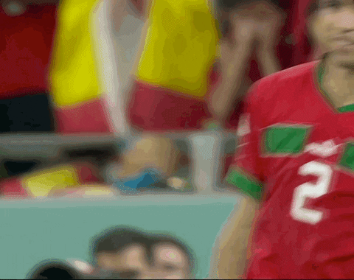
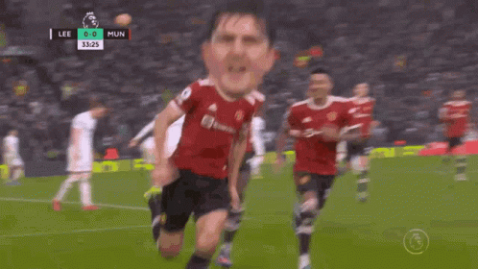
Thanks for watching!!! Subscribe and Like!!

